Slide 1
Functions and Arrays IN C++
CPSC 2320 L2
2020-09-17

Slide 2
What is a function?
A block of code (separate from main)
Only runs when called
Can supply inputs to functions, and collect outputs from it
Input
Function
Output

Slide 3
What is a function
You have already seen functions in C++
Input
sqrt(Input)
cos(Input)
…
Output

Slide 4
Why use functions?
Only write reusable code once
Keep code organized
Makes code extensible
Easier to add on to the program later on

Slide 5
Calling functions
functionName ( data passed to function);
Identifies calling function
Passes data to the function

Slide 6
Calling functions Example
sqrt( number );
Identifies calling function
Passes data to the function

Slide 7
Calling functions Example
pow( number1,number2 );
Identifies calling function
Passes data to the function

Slide 8
Function declarations
<return data type> <function name> ( [input args] )
double doSomething();

Slide 9
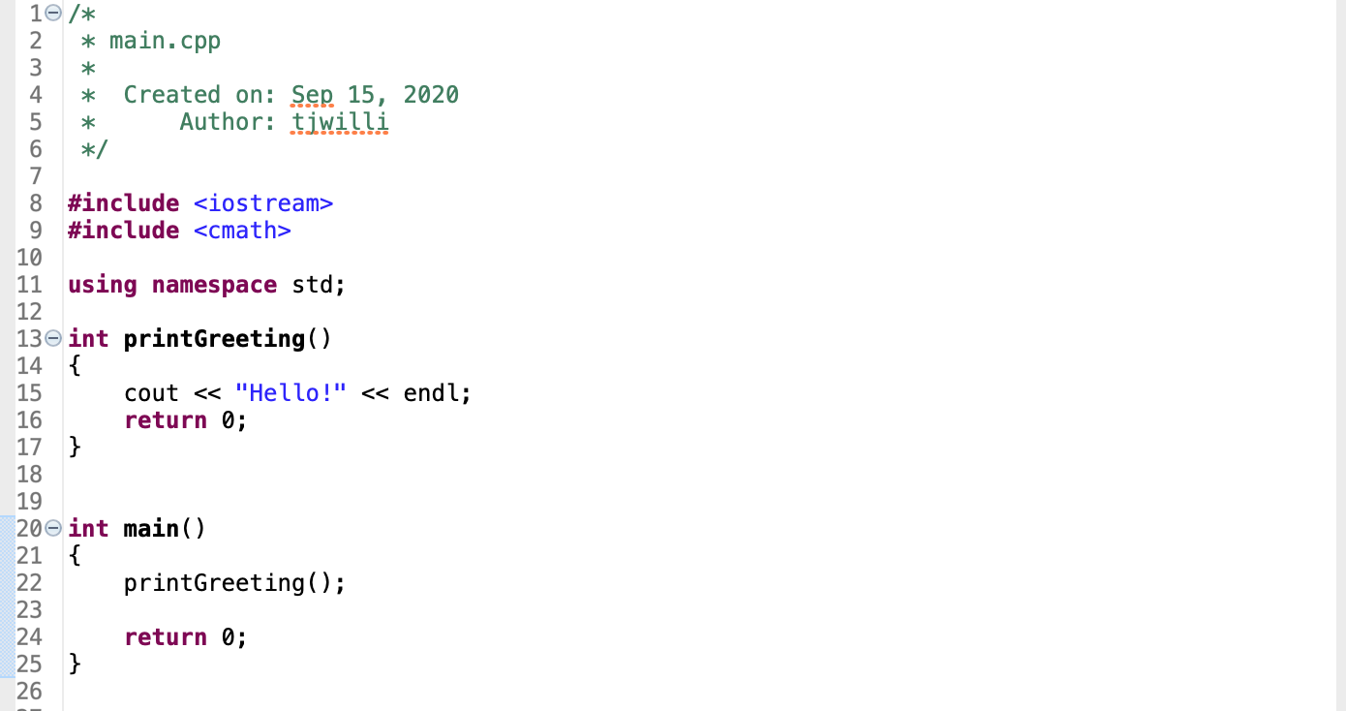

Slide 10
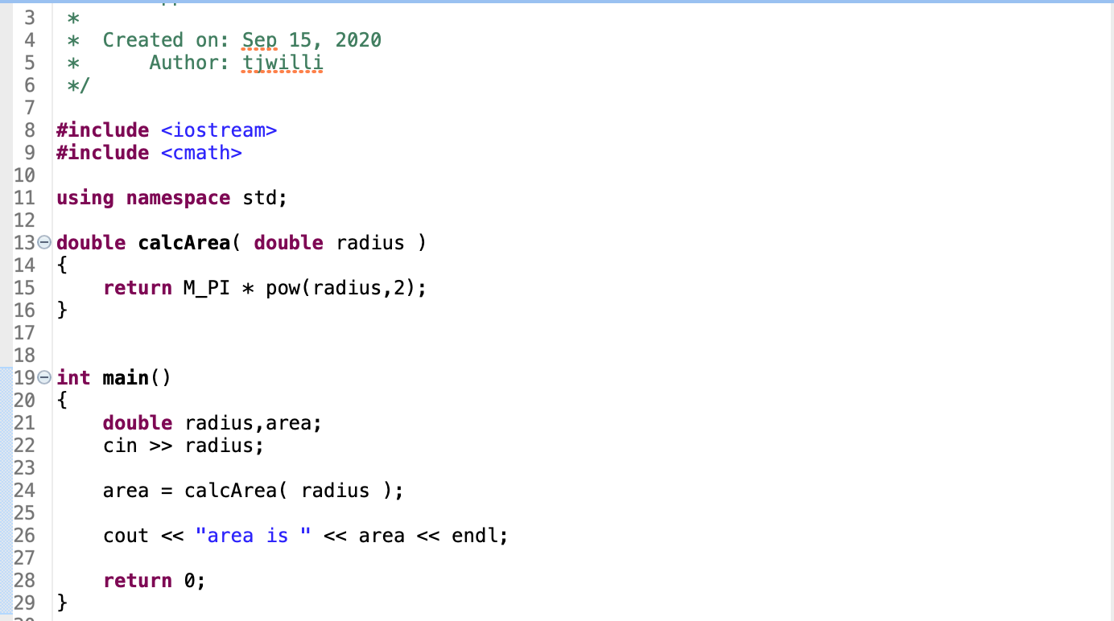

Slide 11
VOID functions
We don’t have to return anything
To declare a function with no return type: use void
void doSomething();

Slide 12
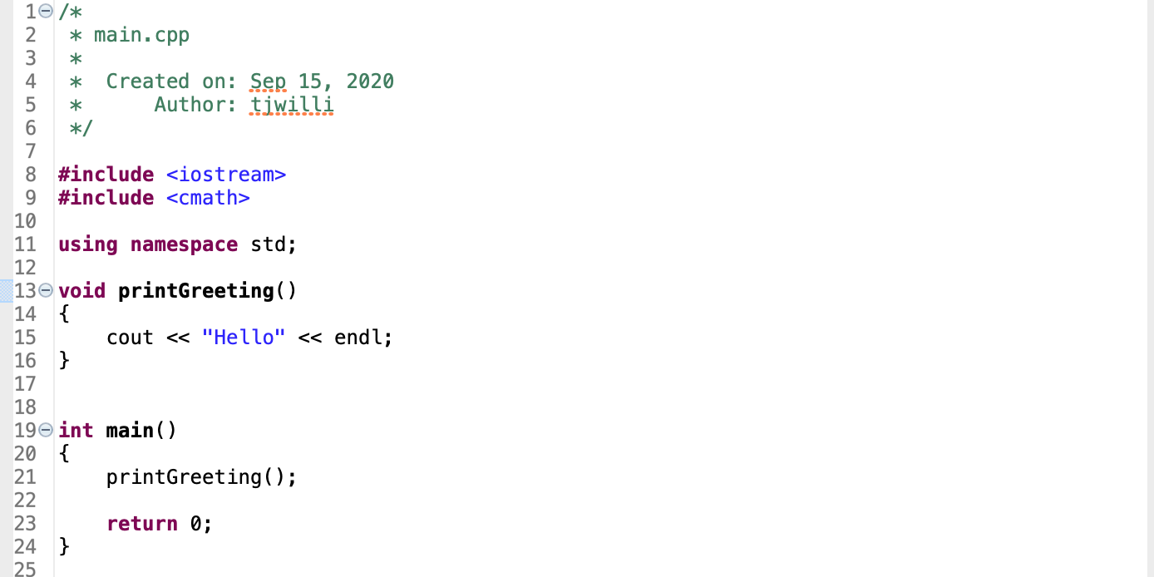
Example

Slide 13
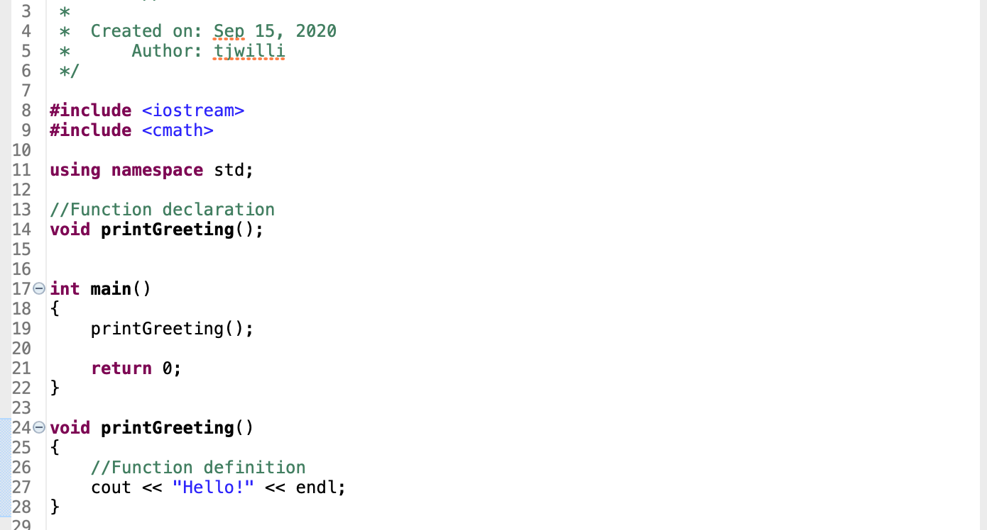
Declaration vs definition
function declared here
(must be declared before main() )
function defined here

Slide 14
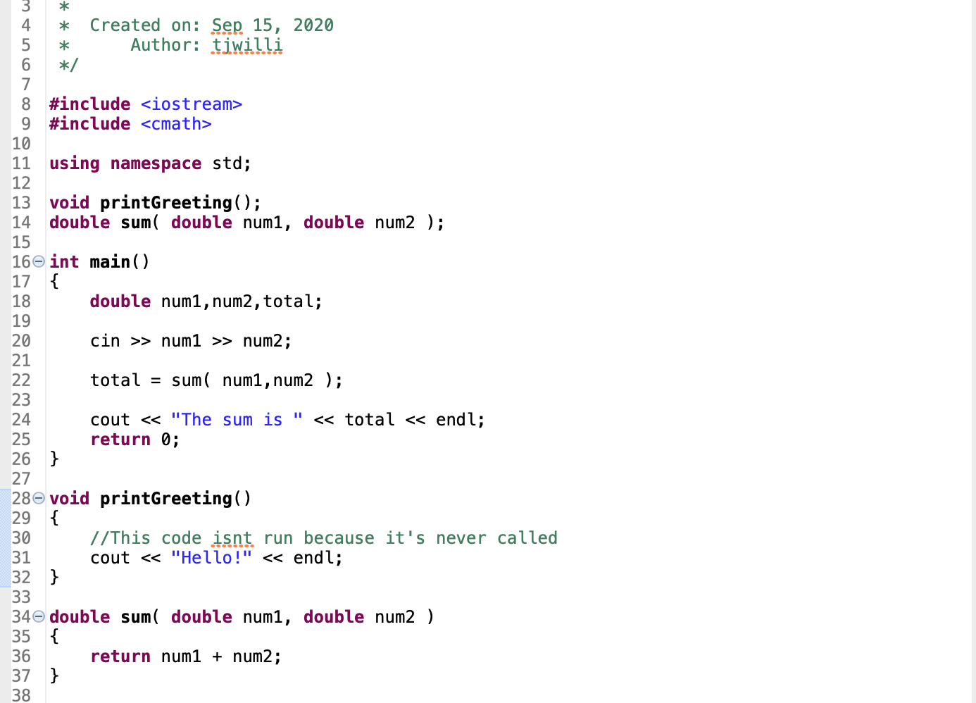

Slide 15
Best practice is to declare before main and define after main

Slide 16
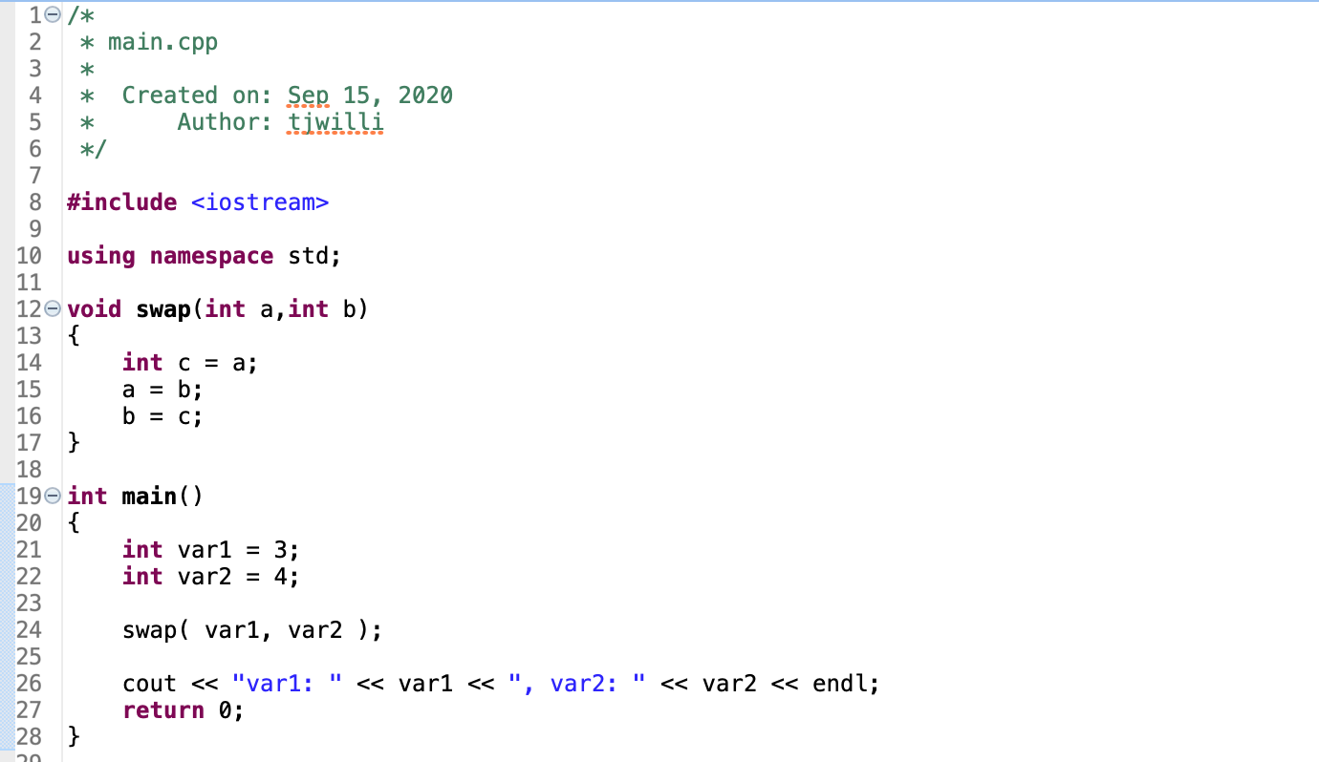
Example

Slide 17
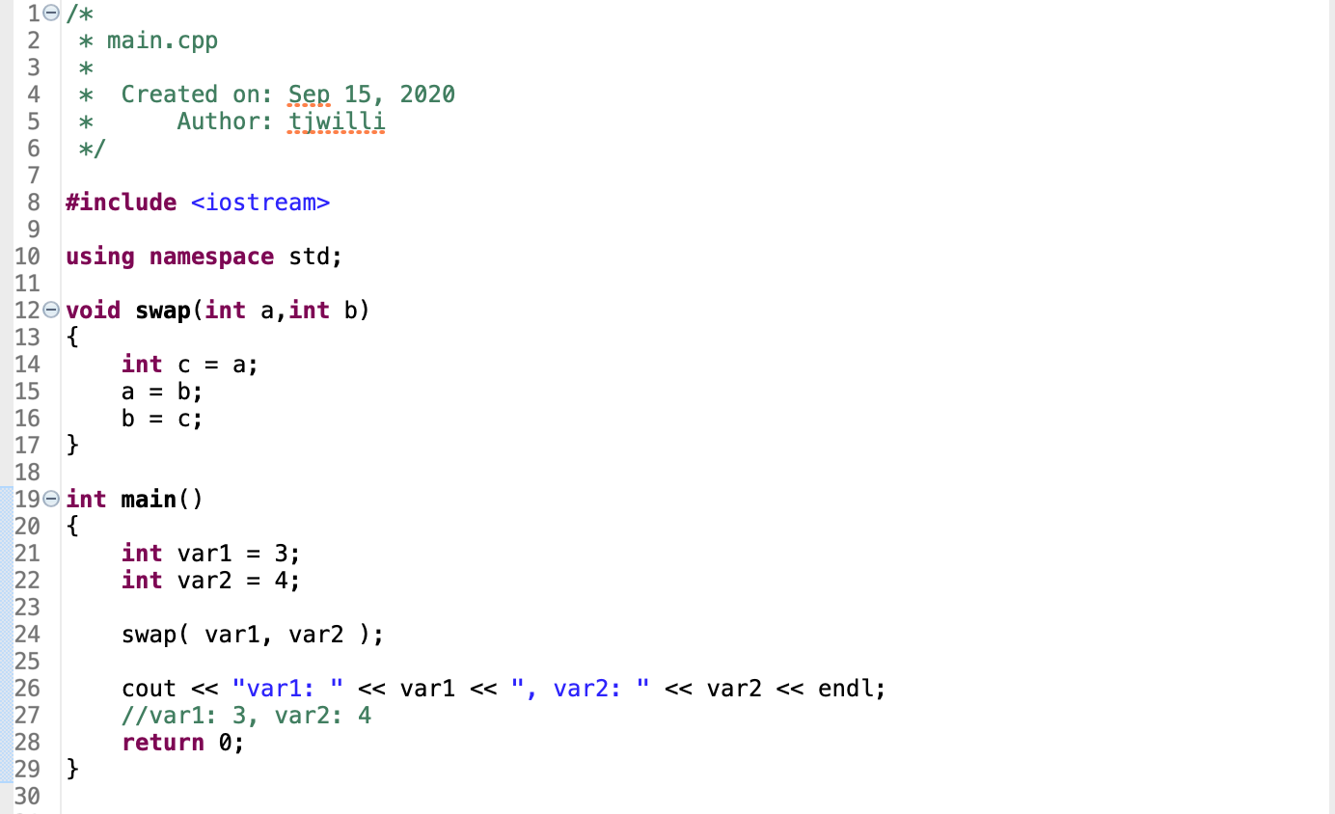

Slide 18
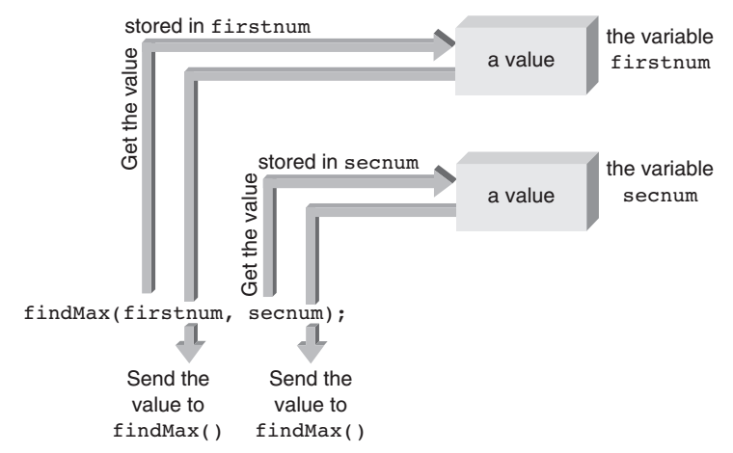
Functions receive copies of variables*
*terms and conditions apply

Slide 19
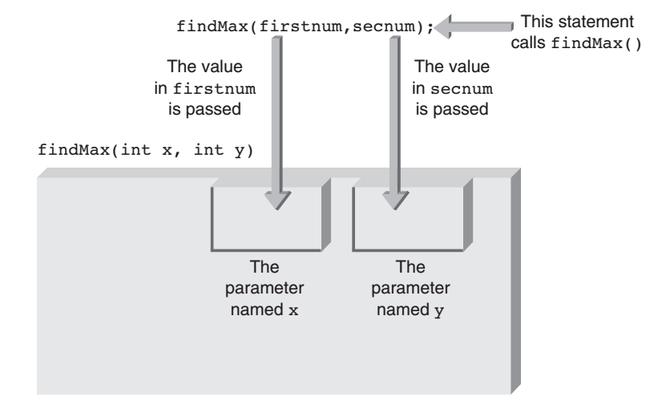
Values copied to function inputs

Slide 20
The function signature
Function signature:
return type, name
number, type, and order of arguments
Function names are not unique identifiers
Function signatures are

Slide 21
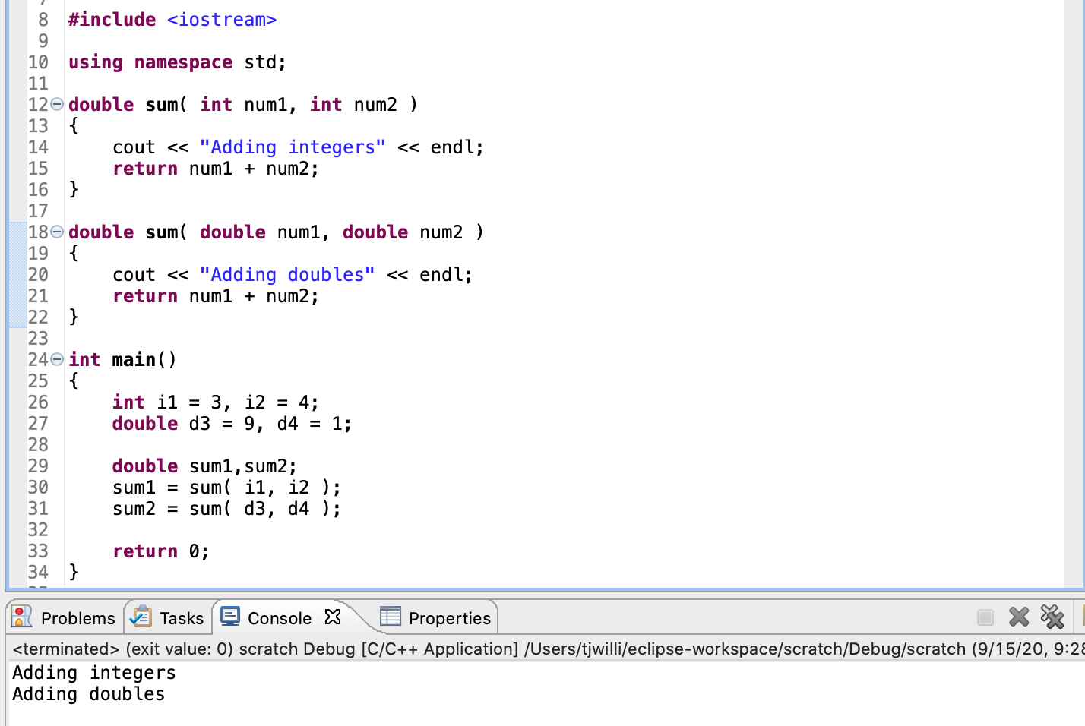

Slide 22
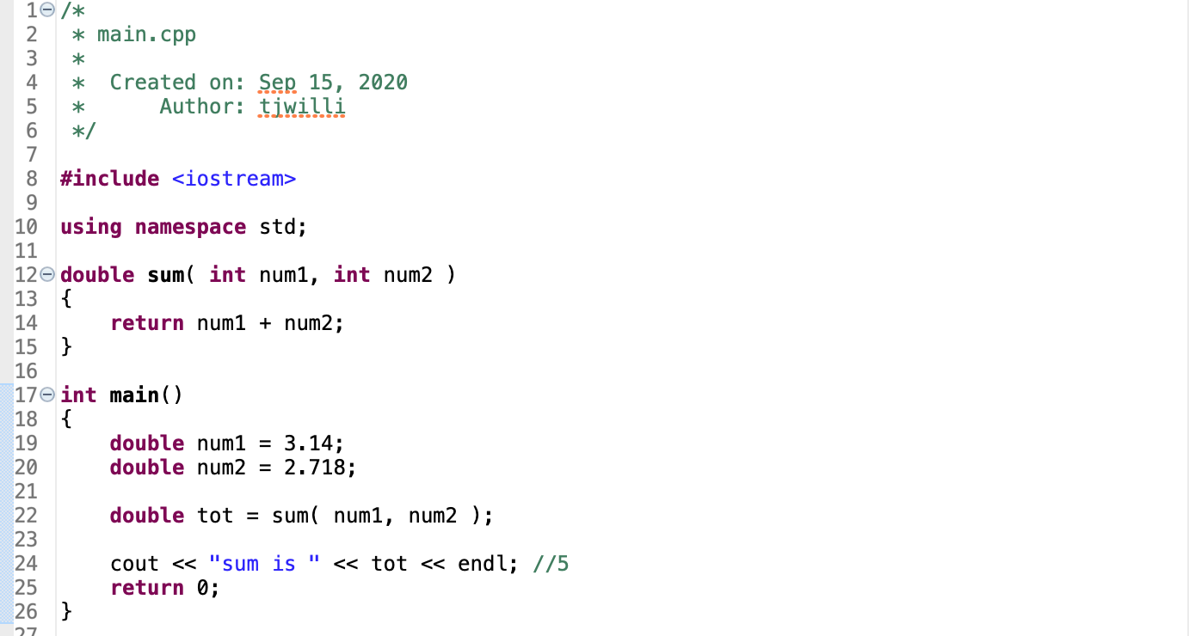
Warning: implicit conversions

Slide 23
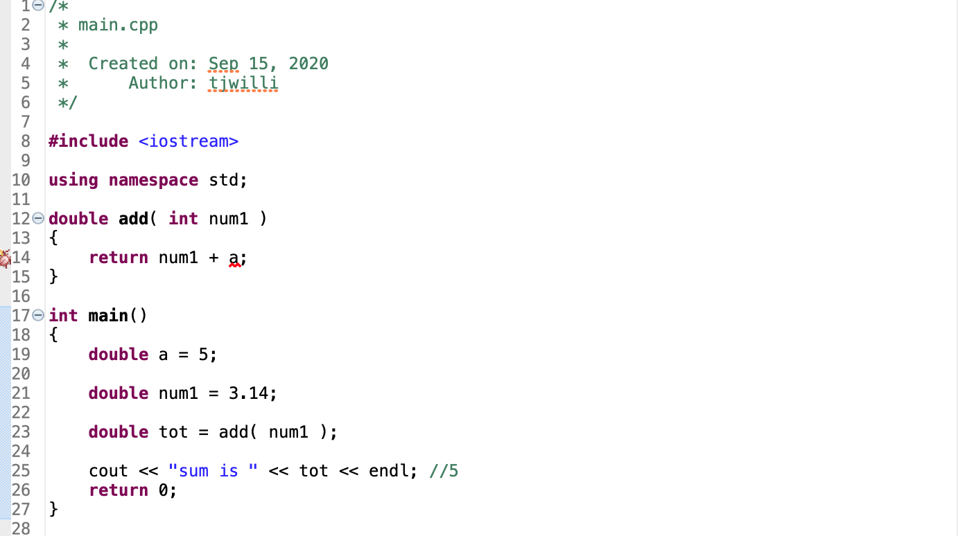
Variable scope
”Symbol could not be resolved”

Slide 24
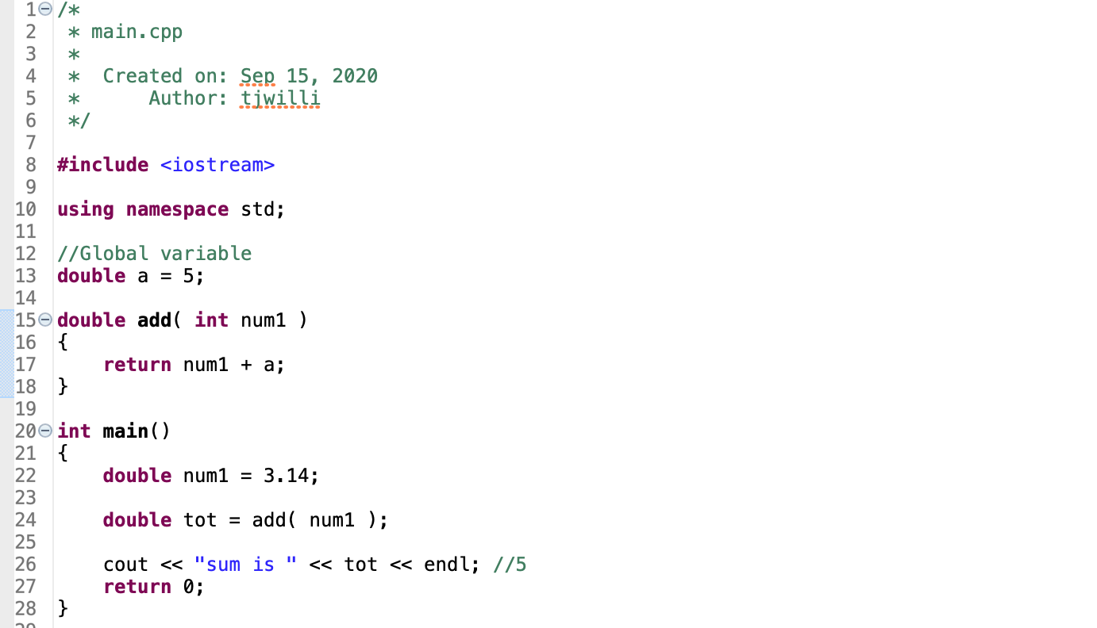
Variable scope
Global variables are available to all functions
Hence the name

Slide 25
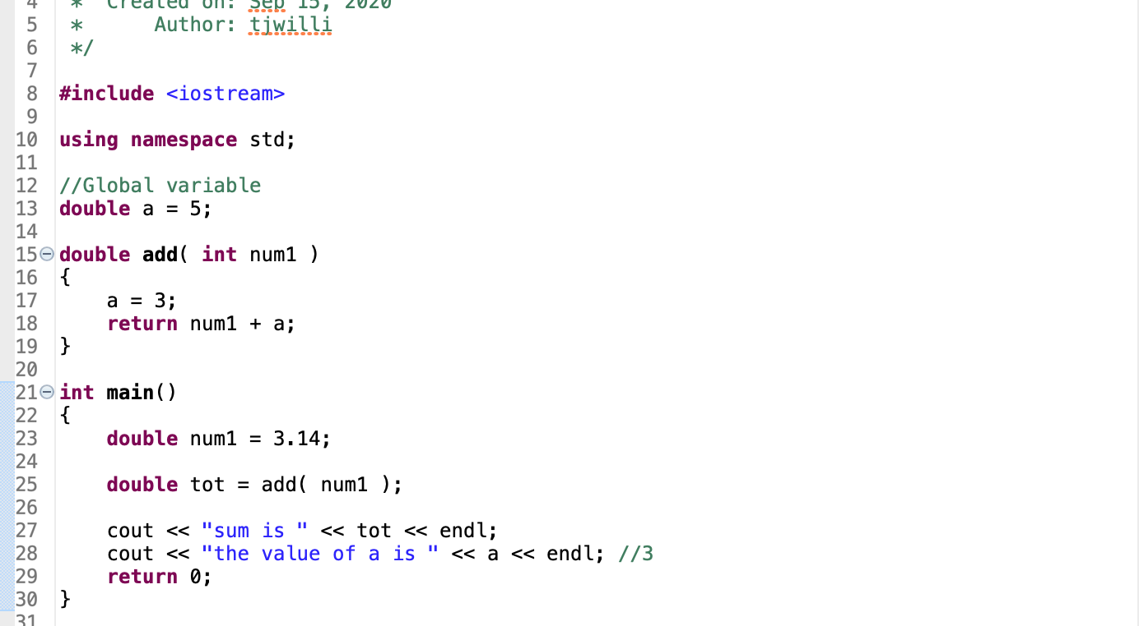
Warning!
Any function can also change a global variable
AVOID GLOBAL VARIABLES WHEN POSSIBLE!!!
*Unless they are constants (const)

Slide 26
Returning multiple values from a function
Unlike Python, we can’t return multiple variables from a function
We can, however, pass multiple variables to the function and give the function permission to change them
This is called passing by reference
Default behavior is pass by value

Slide 27
Pass by reference
Passing by reference supplies the function with the variable’s actual memory address
Normally (pass by value) we retrieve the contents at that memory and copy it to a new location
Here, we pass the location itself

Slide 28
Pass By reference in C++
void swap( double& num1, double& num2)
{
//Code
}
swap( a,b) //Function is called the same way

Slide 29
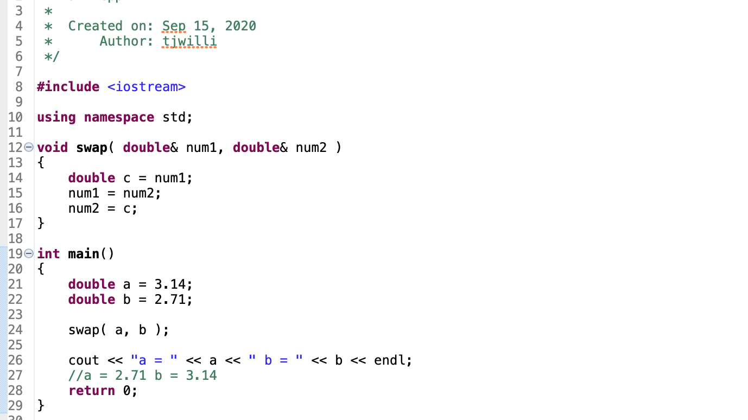
Example

Slide 30
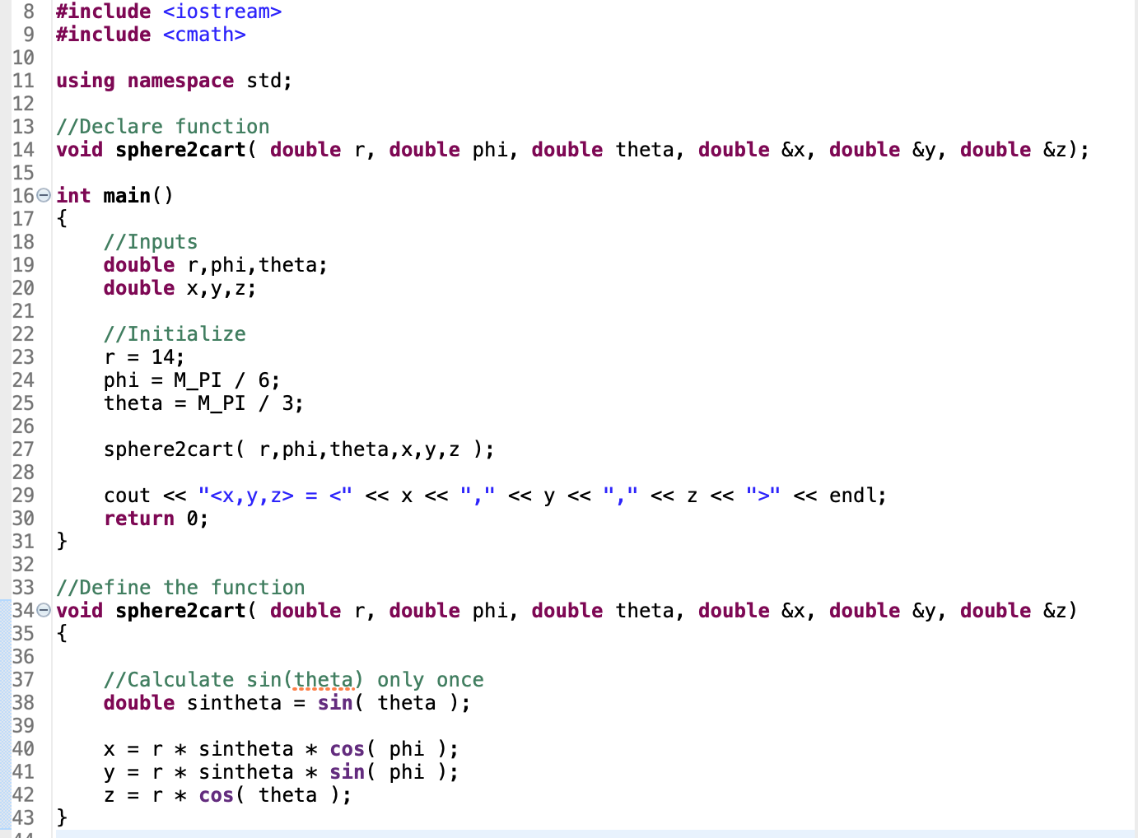
Example

Slide 31
BREAK
WORK ON LAB 2, part 1
Link

Slide 32
Arrays in C++
List of related values all having the same data type
A collection of grades
A list of angles
etc…

Slide 33
Declaring an array in C++
datatype arrayName[number of items]
double grades[10]; //An array of 10 doubles

Slide 34
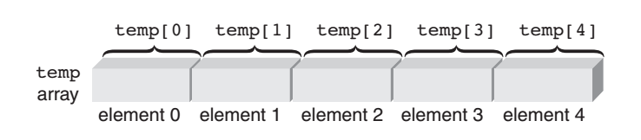
Accessing array elements
Note: array counting starts at 0.
array[0] //first element of the array
array[1] //second
array[i] //ith
array[SIZE – 1] //Final element
Must use integer types to access array elements

Slide 35
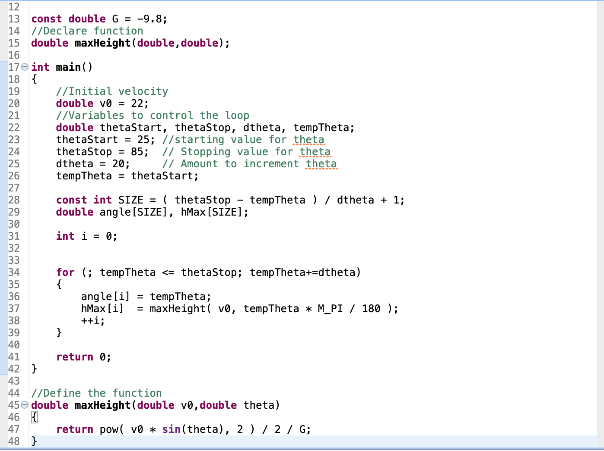

Slide 36
Array bounds
Unlike Python, C++ code will compile and run even if you have code which attempts to access an out of bounds array element
Leads to unpredictable results!

Slide 37
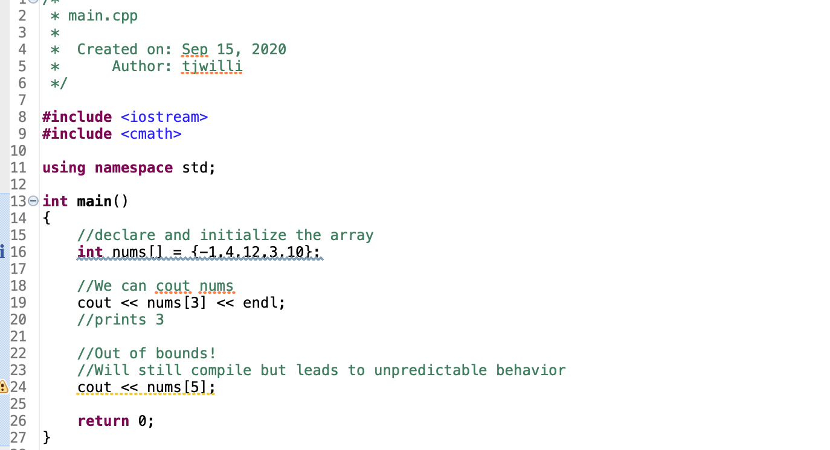
Array bounds example

Slide 38
array initialization
Can create an array like this: int array[] = {1,1,2,3,5};
Identical: int array[5] = {1,1,2,3,5};
Still need the [] to tell the compiler it’s an array, but can omit the number of elements of it’s initialized with a list in brackets

Slide 39
Arrays cannot be variable size
If you use double myarray[SIZE], SIZE must be a const int
You cannot use a “normal” variable to declare an array
Once an array is declared, its size is fixed
Cannot “append” to the end of an array like a python list
If you don’t know how many values you need to store, make the array very large and just don’t use the empty space at the end

Slide 40
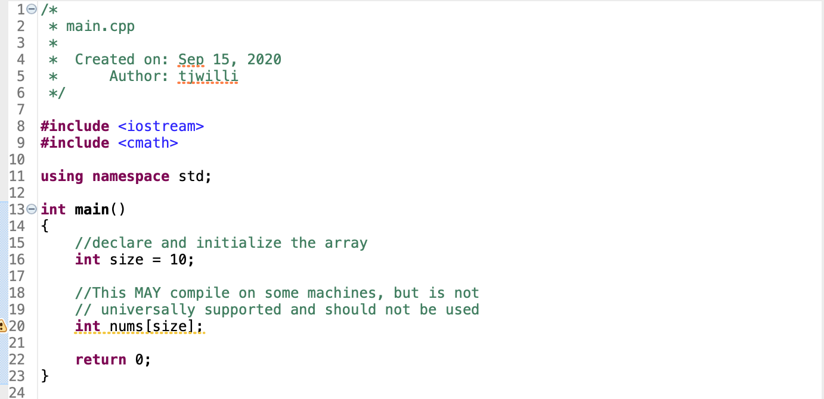
EXAMPLE
It may compile, but you will lose points for this

Slide 41
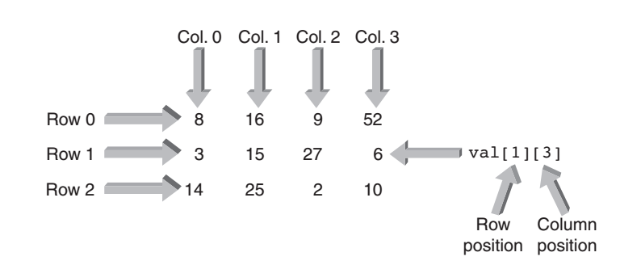
arrays can have multiple dimensions
Useful for
Data tables and matrices
Functions of multiple variables
A 2D array

Slide 42
2D Example
Student 1
Student 2
Student 3
Student 4
95 | 73 | 67 | 20
78 | 89 | 99 | 19
83 | 84 | 98 | 100
Exam 1
Want to store the grades for 3 tests for each of 4 students in a single array
Exam 2
Exam 3

Slide 43
2D arrays in C++
double myArray[number of rows][number of cols];
//Create array for student & exam data
//Number of students and exams
const int NUM_STUDENTS = 4;
const int NUM_EXAMS = 3;
//Declare array
double studentGrades[NUM_EXAMS][NUM_STUDENTS];
studentGrades[1][2] //Grade of second exam, for third student

Slide 44
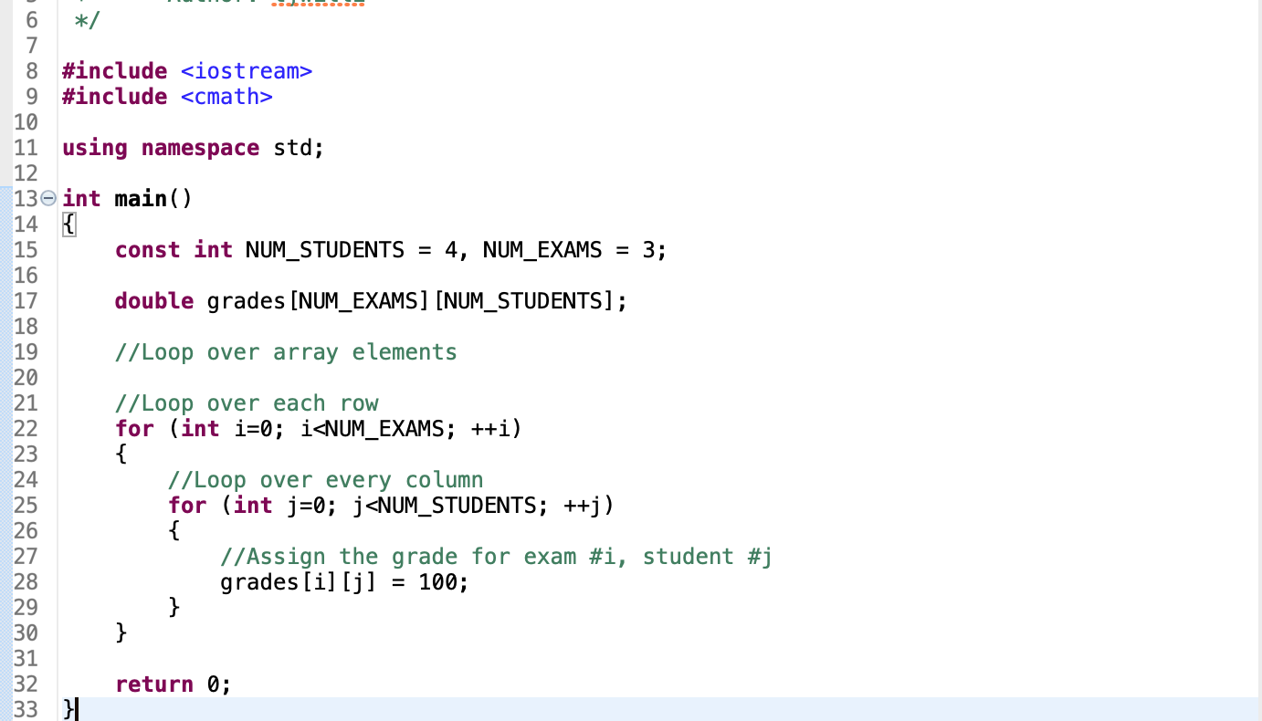
Example

Slide 45
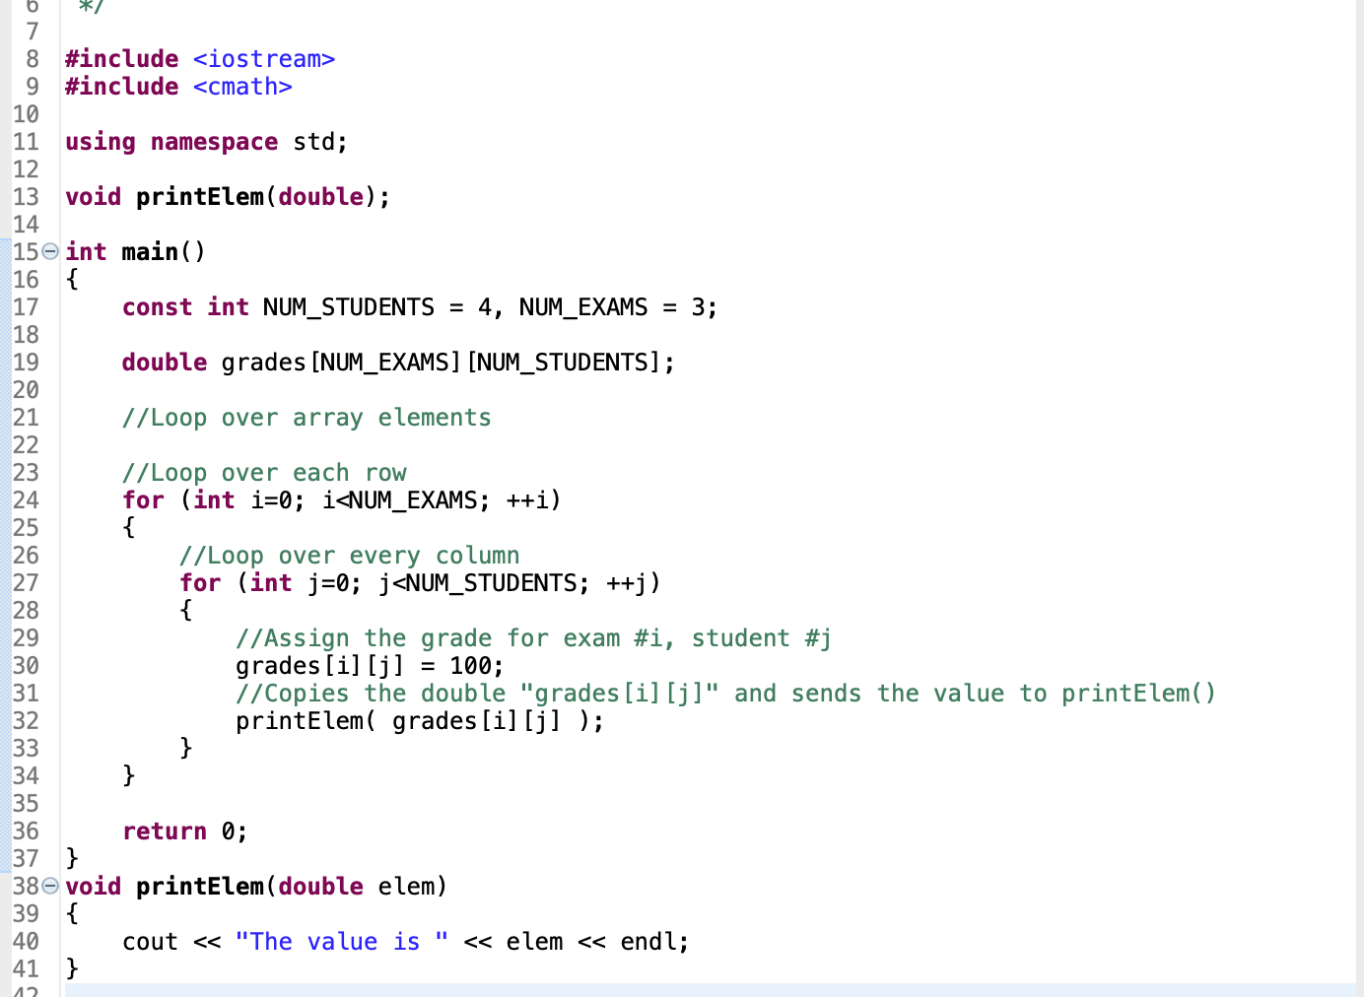
Passing arrays to functions
Array elements can be passed in the usual manner

Slide 46
Passing arrays to functions
We can also pass the entire array to the function
In this case no copy is made, the array is automatically passed by reference
The function has access to the original array, and can make changes to it just like you can in main()

Slide 47
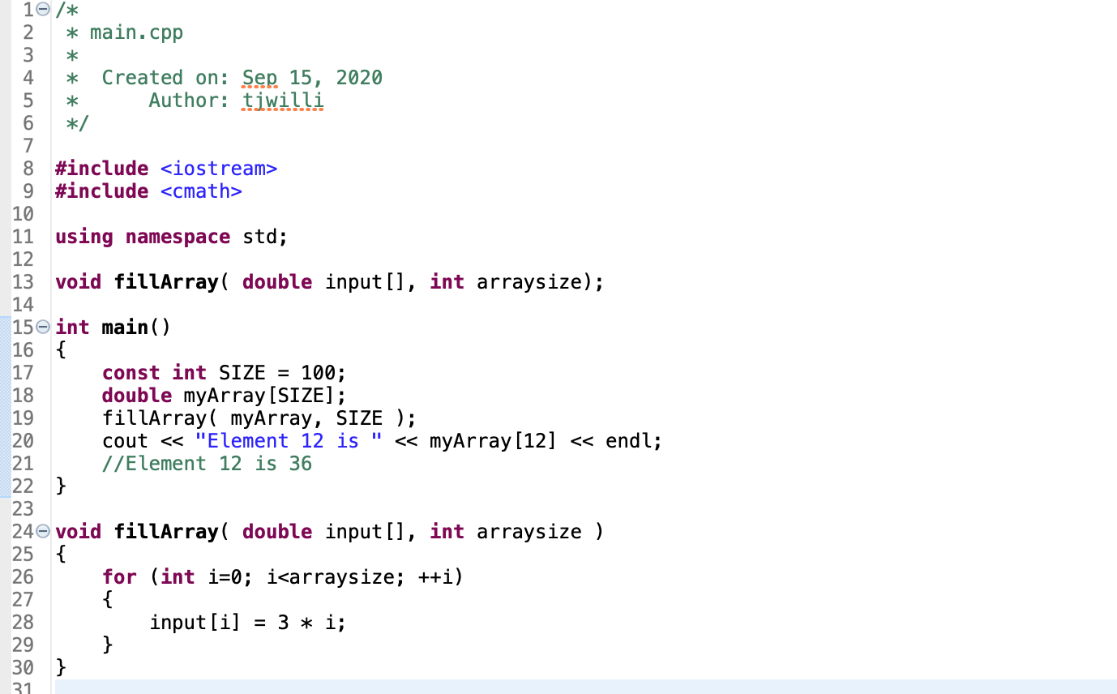
Example

Slide 48
Get the number of elements of an array
Use C++ sizeof() function
Returns the size of the memory occupied by the argument, in bytes

Slide 49
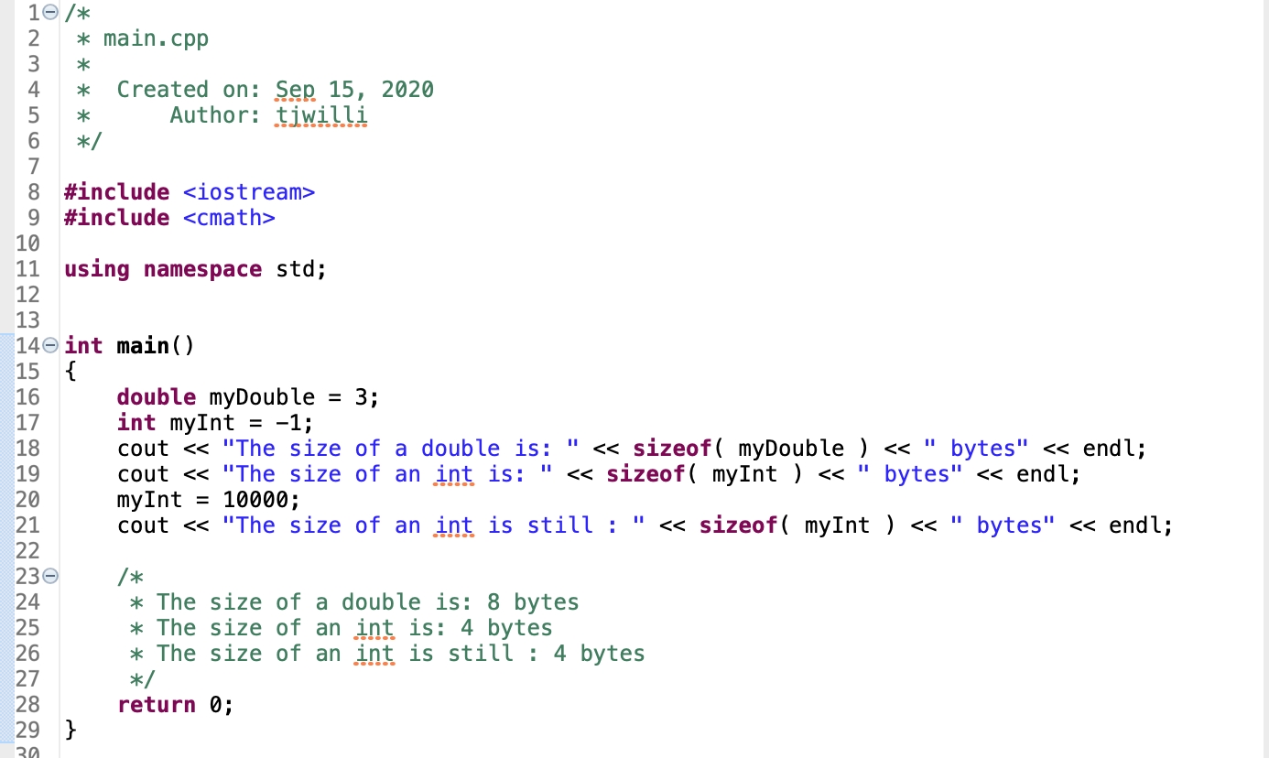
SizeOf()

Slide 50
SizeOF()
The size of an array = (size of datatype) * (number of elements)
Therefore we can use sizeof() to obtain the number of elements in an array
num elements = sizeof(array) / sizeof( array[0] )

Slide 51
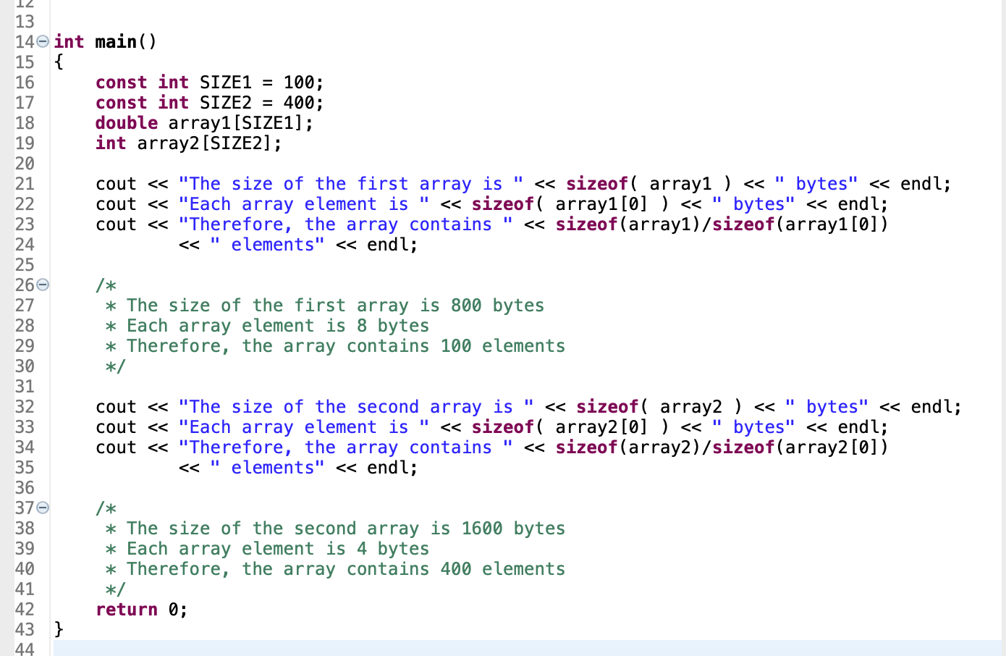
Sizeof()

Slide 52
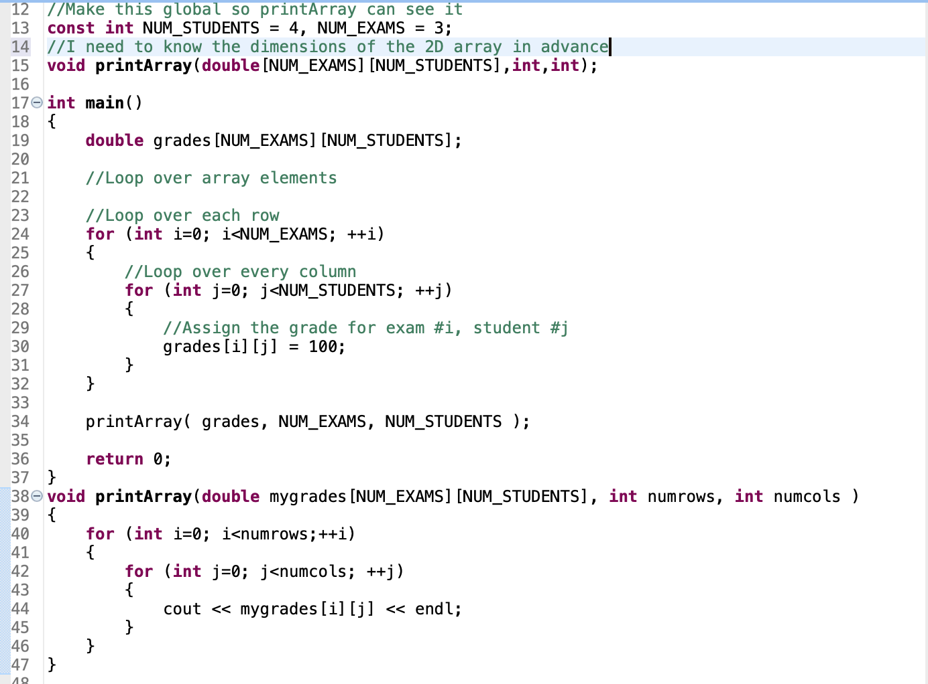
Passing 2d arrays to functions
Need to give the array dimensions in the function declaration

Slide 53
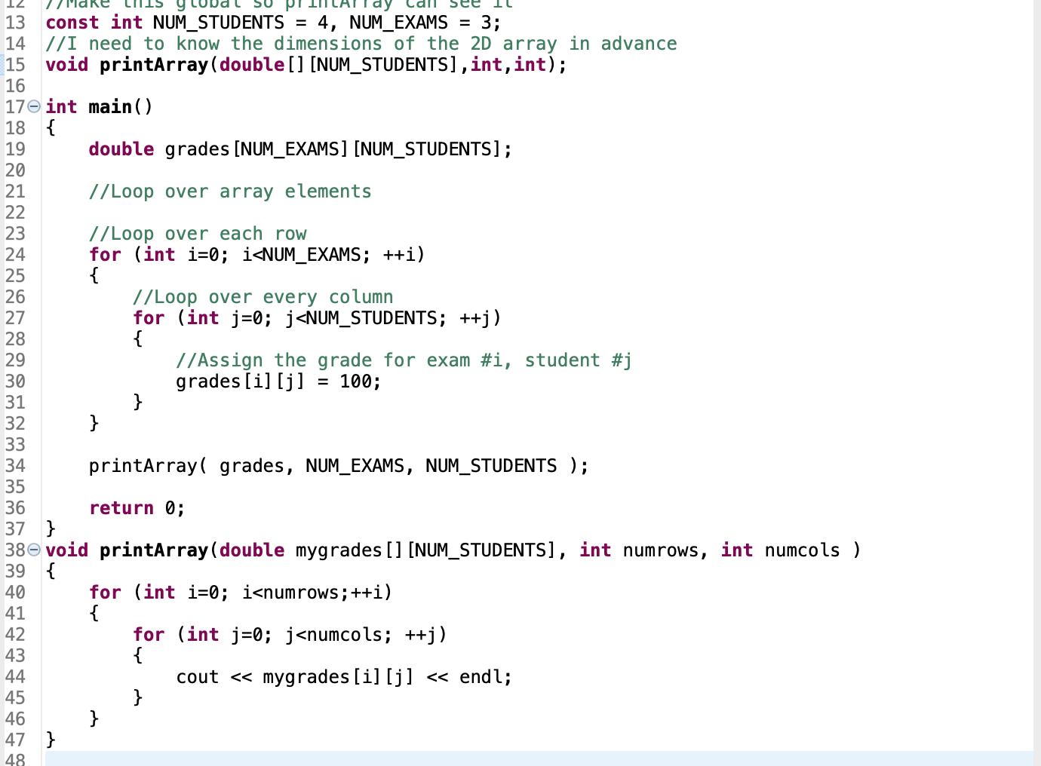
Strictly speaking, we can leave the first dimension blank and only supply the second one
Related to how arrays are stored in memory
We’ll cover better ways of doing this later

Slide 54
That’s all folks
Finish Lab 2
Work on Homework 2

